Slide 1

Where to build your new gym!
Selecting a New Rock-climbing Gym Location in Denver, CO

Slide 2
The warm sunny weather of Colorado give way to the cold snow of winter. Where can climbers go?
Introduction on the problem’s background

Slide 3
To YOUR gym!
We are going to provide you with an array of possible locations that have the maximum potential of financial success and longevity.

Slide 4
Data acquisition and cleaning
- FourSquare’s vast collection of venue location data
-Every currently operating venue in the city

Slide 5
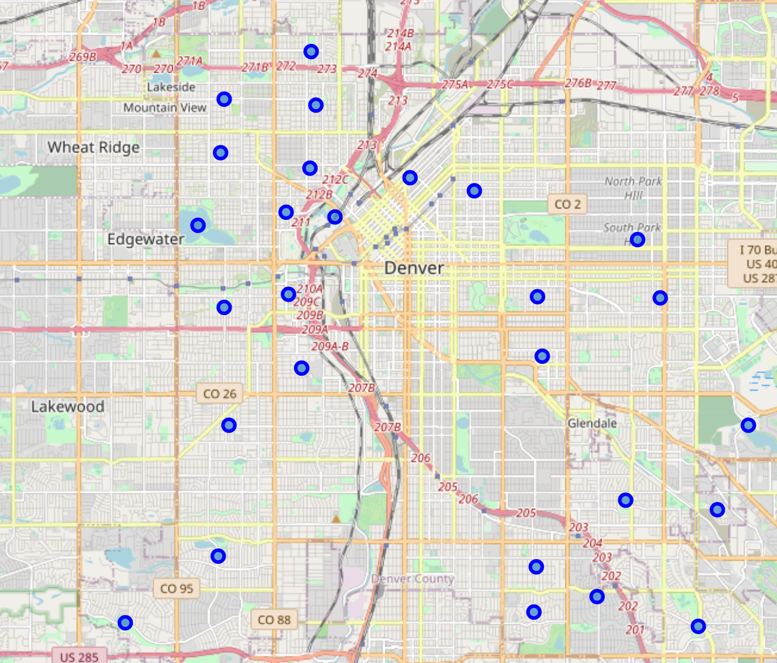
Exploratory data analysis
A Folim map shows that our
neighborhoods are disbursed
uniformly around the Denver
urban center.

Slide 6
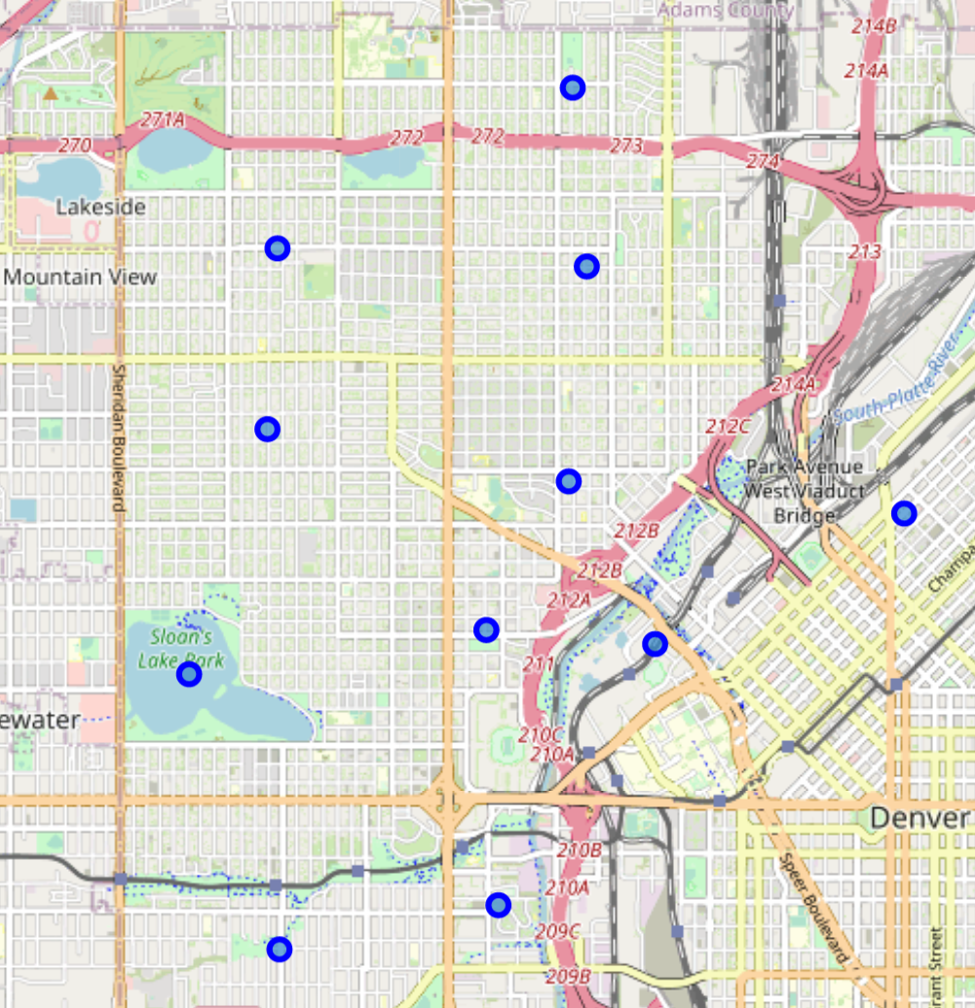
Exploratory data analysis
A particularly dense area of prospective neighborhoods reside in the northwest quadrant.

Slide 7
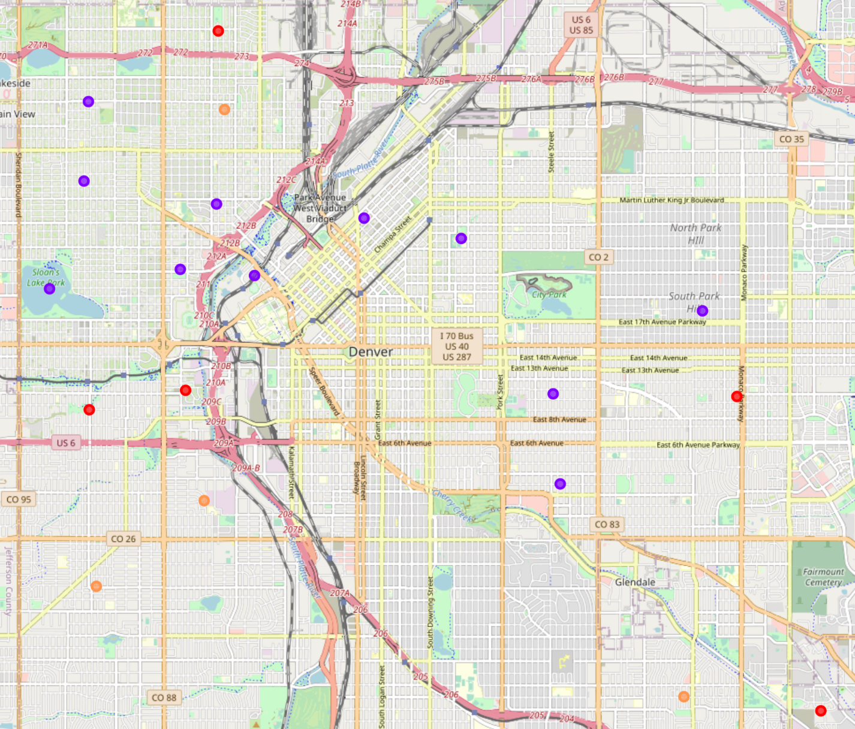
K-means clustering
We utilized k-means clustering to
group or neighborhoods into similar
categories. Once grouped into clusters
we are able to obtain a generalization
of the primary characteristics of each
cluster.

Slide 8
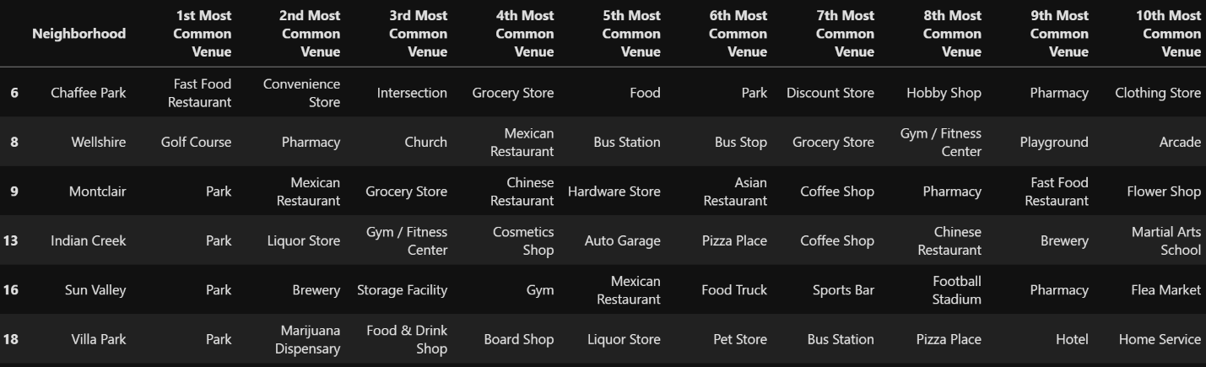
Results

Slide 9
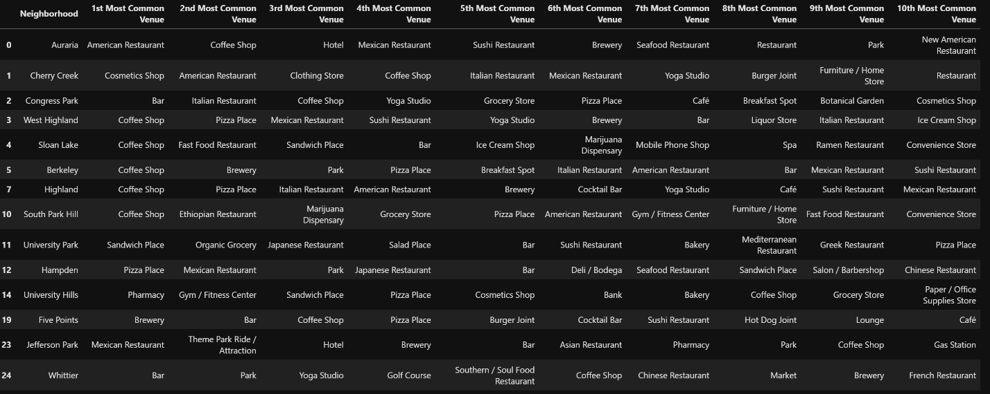
Results, cont.

Slide 10
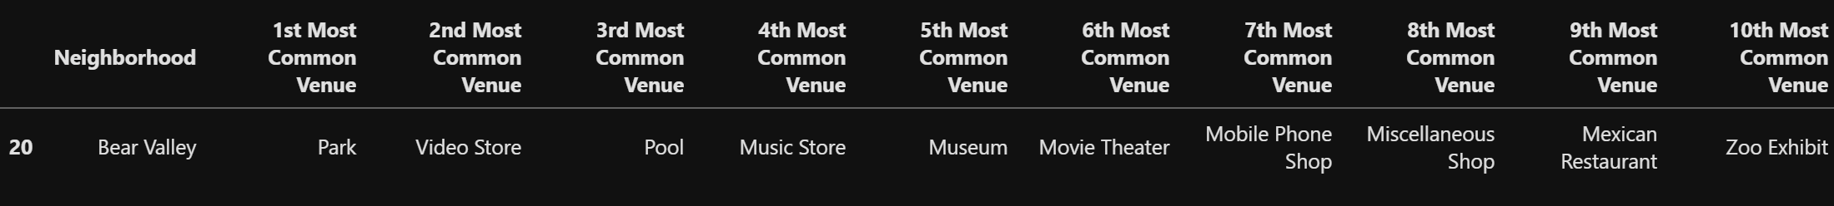
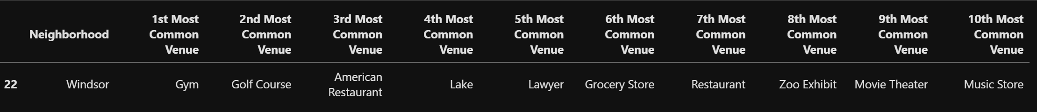
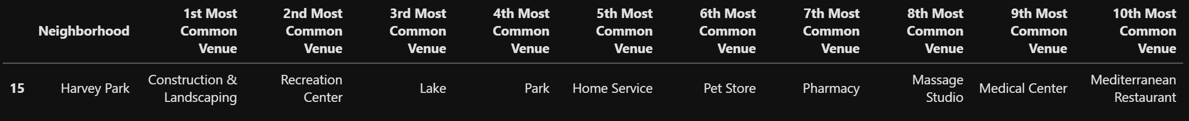
Results, completed

Slide 11
Discussion
-The most promising cluster appears to be Two.
-The most common venue categories seem to indicate a large population of younger professionals are even college students.
- A domain study will help determine the neighborhoods within this cluster than will provide the maximum compatibility with your decision.

Slide 12
Conclusion
-While many neighborhoods show promising characteristics as potential locations for opening an indoor rock-climbing gym, several stand out as potential candidates.
-Our preliminary analysis indicates the Five Points neighborhood as the most efficacious location.
-Final surveys and polls will be conducted to further substantiate data and modeling processes.

